Slide 1


.
Data Visualization Project

Slide 2



Exploring Disney Movie Gross Income Dataset
An Analysis of Disney Movie Trends and Performance
This Photo by Unknown author is licensed under CC BY-SA.

Slide 3
Introduction
Walt Disney Studios is the foundation on which The Walt Disney Company was built. The Studios has produced more than 600 films since its debut film, Snow White and the Seven Dwarfs in 1937. While many of its films were big hits, some of them were not. This dataset contains all the movies from 1937 to 2016 that were released by Disney.

Slide 4

About the Dataset
The data contains 579 Disney movies with six following attributes:
movie_title
release_data
genre
mpaa_rating
total_gross
inflation_adjusted gross..

Slide 5

Data Preprocessing
1. Handling Missing Values:
Identify columns with missing data, such as 'genre' and 'mpaa_rating.'
Decide how to handle missing values. For example, you might choose to fill missing 'genre' values with a default category like 'Unknown' and missing 'mpaa_rating' values with a default rating like 'Not Rated.'
Use methods such as ‘.fillna()’ from pandas to apply these changes.
2. Creating New Columns:
Generate new columns like 'release_year' and 'decade' based on the 'release_date' to extract relevant information for analysis.

Slide 6
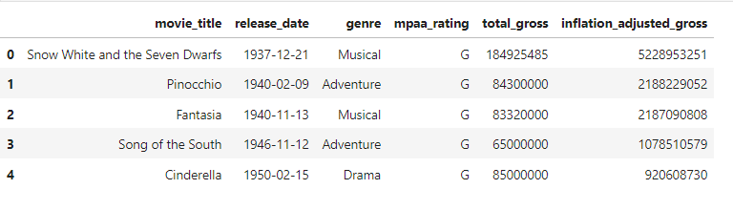
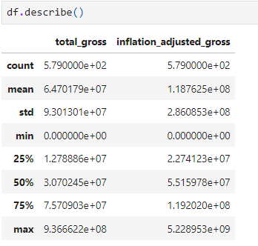
Exploratory Data Analysis
1. First 5 rows of the Dataset..:
we have used
‘df.head(5)’ method to display
the first five rows of the
dataset
2. Summary Statistics for Numerical Columns..:
we have used ‘df.describe()’ method to
display the Summary Statistics for Numerical Columns

Slide 7

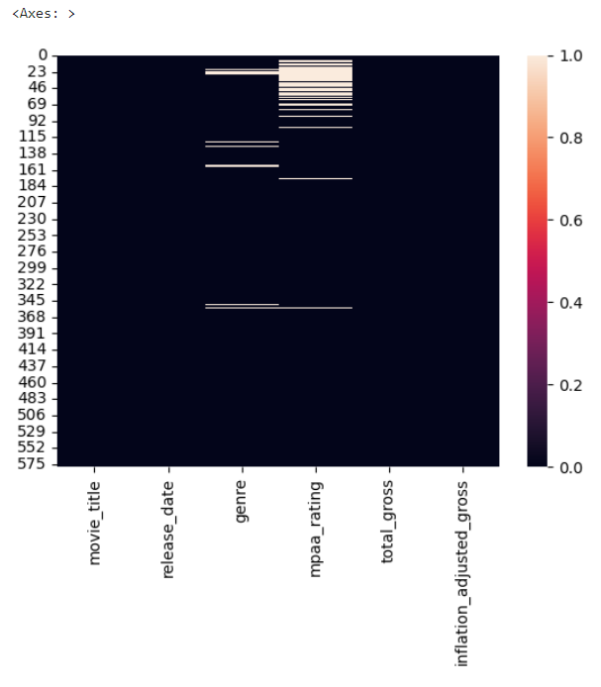
Missing Data
A Heatmap of Missing data in the
Dataset..:

Slide 8
Trends Over the Years
Animation is consistently the highest-earning genre among Disney movies
In the earlier years, particularly from the late 1930s to the 1950s, musicals were a prominent genre that generated substantial earnings.
In the 1990s, there is a notable diversity in the genres that achieved high earnings.
The 2010s saw a resurgence in the earnings of animated Disney films.
Adventure and Family genres have consistently performed well throughout the years.
The visualization demonstrates how the landscape of Disney movies has evolved over time.
While there are overall trends, it's important to note that there is variability from year to year. The success of individual films within each genre can lead to fluctuations in earnings. Some years may see a standout film that significantly impacts earnings for a particular genre.
Disney's ability to adapt and shift its strategy over the years is evident. They have been successful in creating blockbusters in multiple genres, showcasing their ability to cater to diverse audiences.

Slide 9
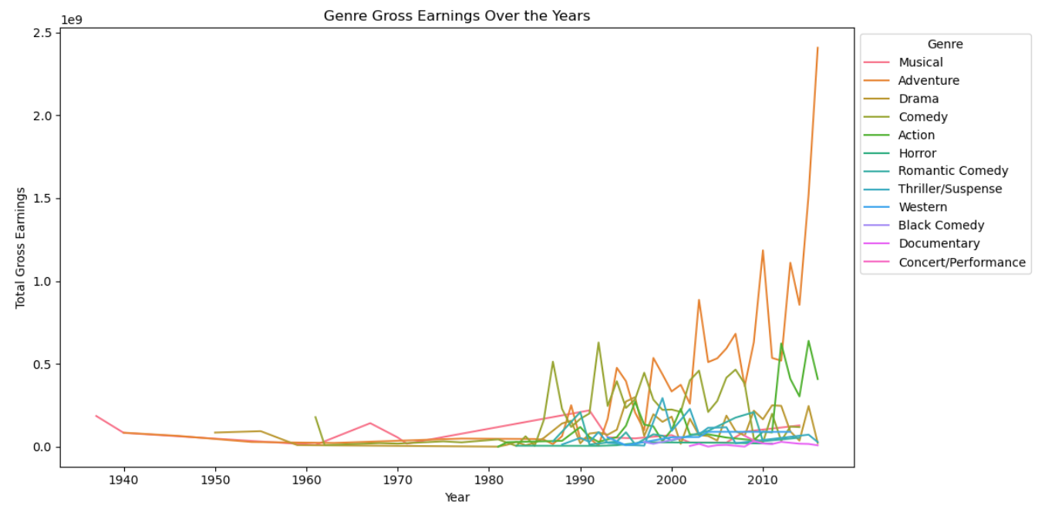
.

Slide 10

Trends Over the Years
The "Genre Gross Earnings Over the Years" visualization demonstrates the raw financial success of various genres over time. It shows which genres had the highest earnings in nominal terms, which may include a bias towards more recent films due to inflation.
In contrast, "Genre Inflation-Adjusted Gross Earnings Over the Years" reveals the genres that have consistently performed well when accounting for the changing value of currency. It might highlight genres that maintained their earnings power over time.
By comparing these two visualizations, one can identify genres that not only earned the most in nominal terms but also retained their financial strength over the years when adjusted for inflation. This can provide insights into the enduring popularity and profitability of certain genres.

Slide 11
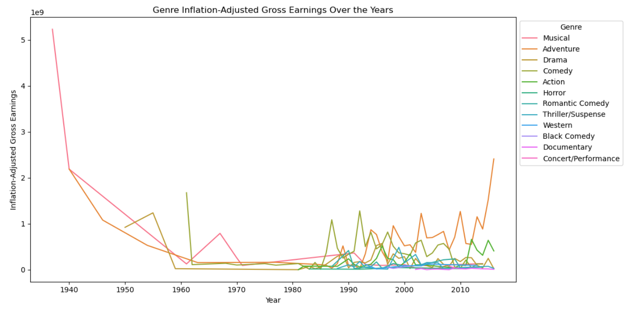
.

Slide 12
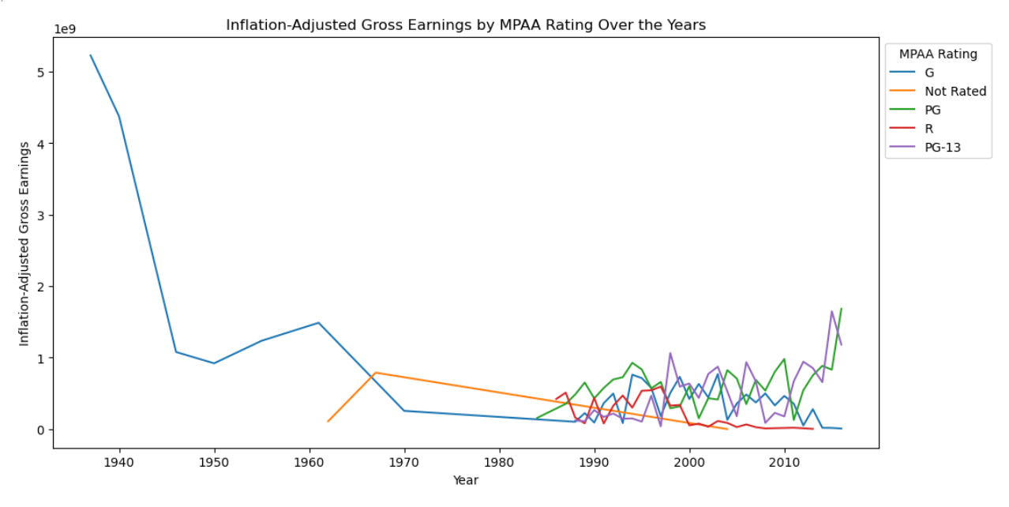
MPAA Ratings Analysis
The choice of MPAA rating has a substantial impact on a movie's inflation-adjusted gross earnings over the years. PG-13 movies tend to perform consistently well, while PG and G-rated movies also maintain their popularity.
R-rated movies, although
occasionally successful, have more
variability in their earnings.
The impact of rating isinfluenced
by audience preferences, genre,
and the quality of content.

Slide 13
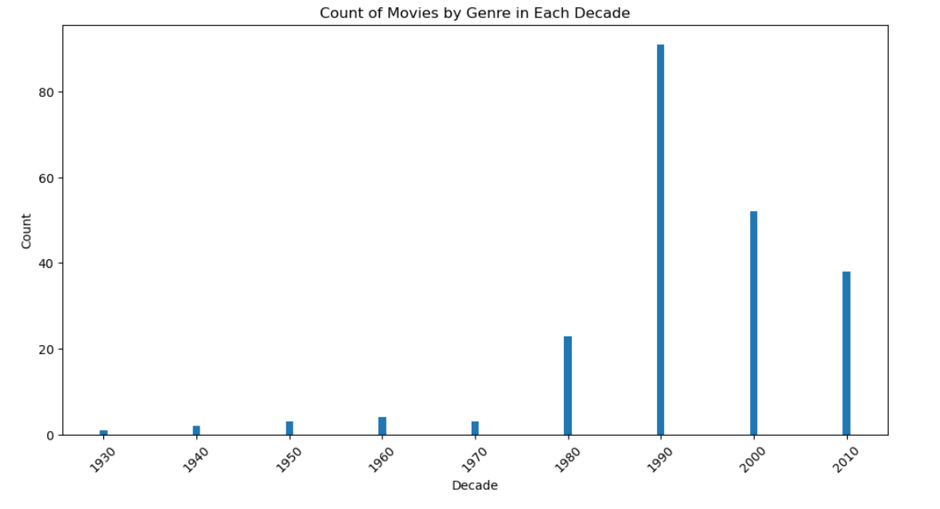
Decade Analysis
The evolution of Disney movies over the decades reflects the studio's ability to adapt to changing audience preferences and industry trends.
From classic fairy tales to
the expansion into franchises
and streaming, Disney has
remained a dominant force
in the world of entertainment.

Slide 14
Movie Franchise Classification
Classifying movies into franchises is a strategic approach used by studios to create enduring and profitable film series with shared elements, allowing for extended storytelling, audience engagement, and brand recognition. These franchises often become cultural phenomena and play a significant role in the film industry.
franchise_dict = {
"Toy Story": "Pixar",
"Pirates of the Caribbean": "Disney",
"Cars": "Pixar",
"Prince of Persia": "Other",
"Muppets": "Disney",
"Marvel": "Marvel",
"Star Wars": "Star Wars"
}
In this dictionary, the keys represent the movie titles, and the values represent the respective franchise or production company associated with each movie. The dictionary is used to classify movies based on their franchise affiliation, and it helps analyze how movies with franchises performed compared to those without franchises.

Slide 15
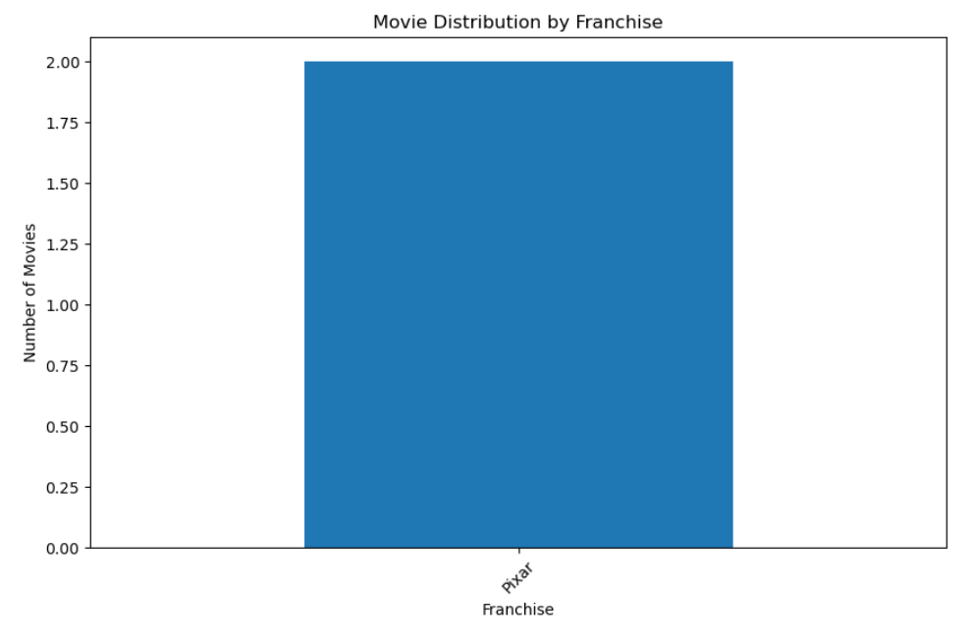

Movie Distribution by Franchise
The distribution of movies among these franchises illustrates Disney's diverse portfolio, including its ownership of other major brands like Pixar, Marvel, and Star Wars. Each franchise has its unique style, audience, and storytelling, contributing to Disney's overall success. This strategy allows Disney to appeal to a broad spectrum of viewers and leverage the established fan bases of these franchises.

Slide 16
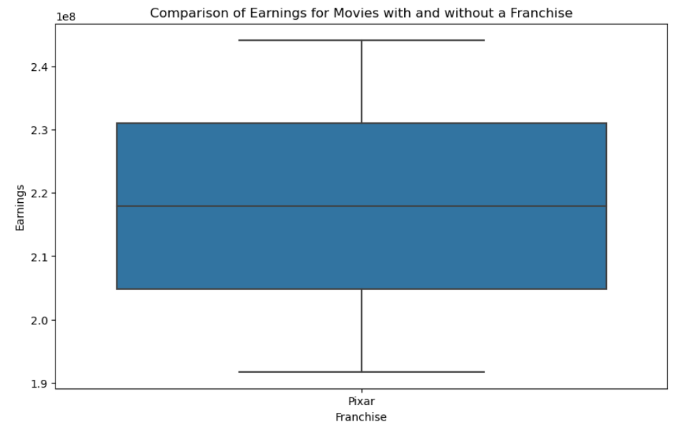
Franchise vs. Non-Franchise Earnings
The key difference in earnings distribution between movies with and without a franchise is the level of predictability and consistency. Movies within established franchises tend to have more stable and predictable earnings, while standalone movies have a wider range of earnings and may include surprise hits. The choice between producing franchise films
and standalone movies often depends on a
studio's risk tolerance, creative goals,
and audience-targeting strategies.

Slide 17
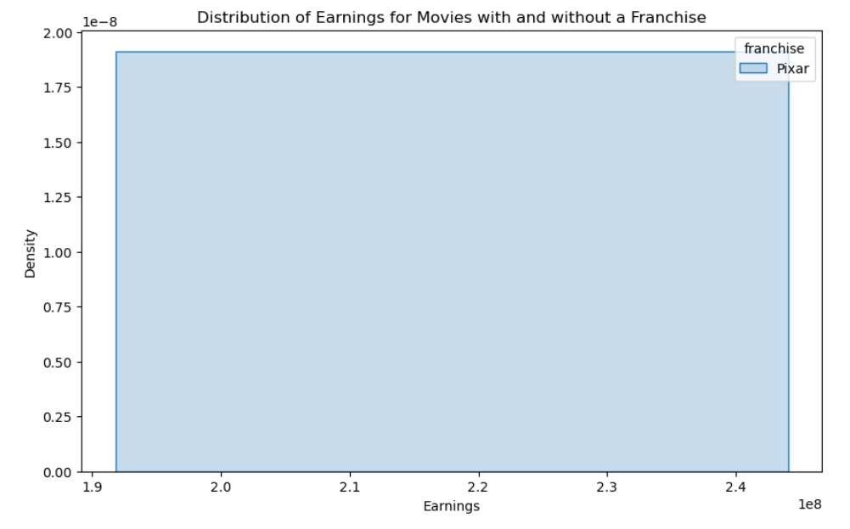
Franchise vs. Non-Franchise Earnings
Movies with a franchise affiliation tend to have a more stable and predictable distribution of earnings, with a narrower range and a higher median. In contrast, standalone movies have a wider distribution of earnings, with a greater potential for both success and underperformance.
The choice between producing franchise
films or standalone movies often depends
on a studio's risk tolerance, creative
goals, and business strategy.

Slide 18
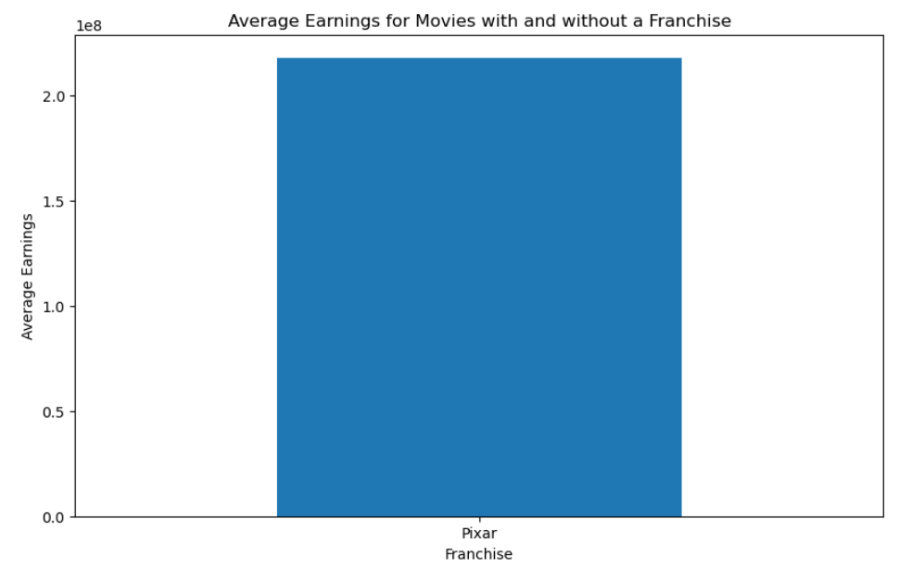
Average Earnings by Franchise
In terms of overall financial performance, the MCU and "Star Wars" franchises have been particularly strong. The MCU, in particular, has consistently delivered both critical acclaim and high box office earnings, making it one of the most successful and enduring franchises in the history of cinema.
It's important to note that each franchise
offers its unique appeal and targets different
demographics. The definition of "better"
performance may vary depending on the specific
metrics and criteria used, whether it's box office
earnings, critical reception, fan engagement, or
cultural impact. Ultimately, the success of a
franchise depends on its ability to resonate with
audiences and maintain its relevance over time.

Slide 19
Conclusion
In summary, Disney's success in the film industry is attributed to its ability to adapt to changing audience preferences, leverage the strength of its franchises, and produce a wide range of content, from classic fairy tales to blockbuster franchises. The choice between franchise and standalone movies depends on factors like creative goals, financial strategy, and audience targeting.
Data analysis is crucial in decision-making because it provides valuable insights, patterns, and trends that inform informed choices. It helps organizations optimize strategies, enhance efficiency, mitigate risks, and identify opportunities, ultimately leading to better and more data-driven decisions.

Slide 20

.

